Slide 1
Web Based Assistant Robot For Visually Impaired patients
Project Guide:
Dr.S.Senthil Kumar
Dept. of EIE
VNRVJIET
Presented by:
D. Karthik Kumar (19071A1066)
M. Krishna Dhanush (19071A1085)
P. Vinay Kumar(19071A1094)

Slide 2
Presentation Outline
Objective
Introduction
Literature Survey
Block diagram : Assistant Robot
Flow chart
Methodology
Hardware and Software Required
Results
Prototype
Applications
Conclusion and Future Scope
References

Slide 3
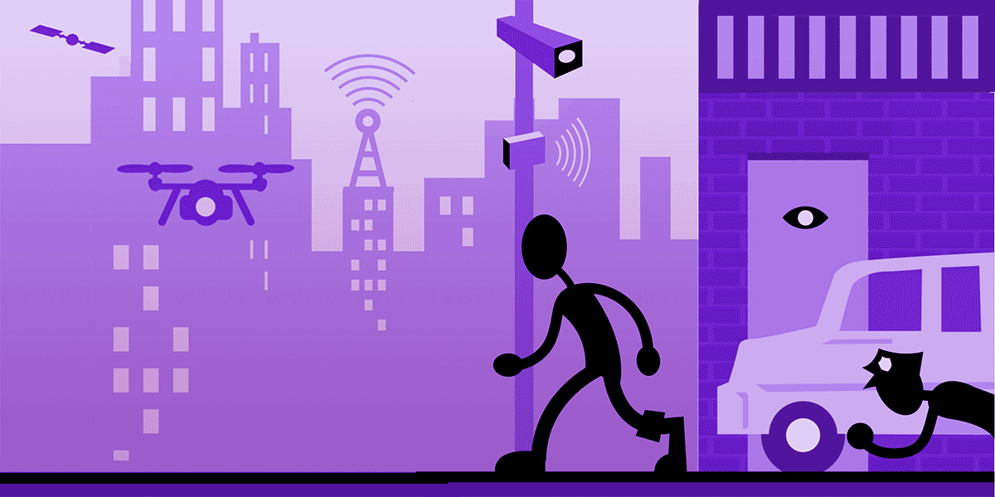
Objective
The goal is to build a moving lane assistant robot which is mainly incorporated of Webcam, Raspberry pi.
Main functions of the resulting robot is to monitor the surroundings remotely for security purposes, and also the same robot can be used as a guide/Assistant by blind individuals to reach their destination in a more precise way.
The final prototype can be used both for surveillance and also as a guide for blind individuals in the same time.

Slide 4
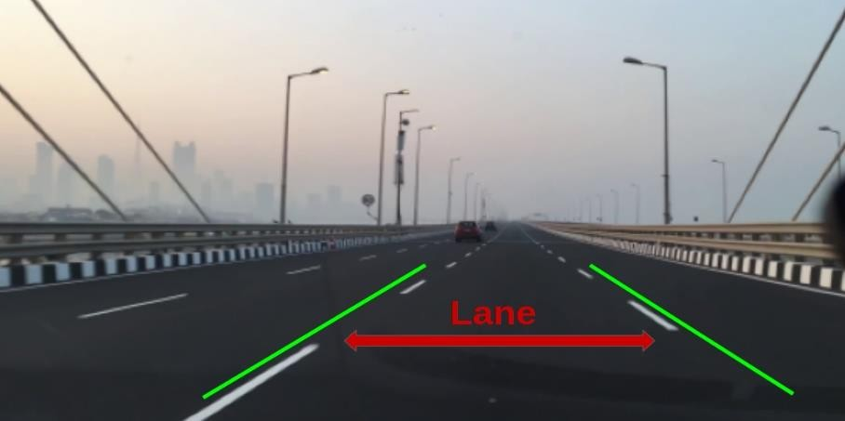
Introduction
Surveillance is a common term which we come across on daily basis.
So, the team considered to build an application driven robot with a function which helps old people/Visually impaired patients to reach their destination in a precise way with in their premises.
The same robot also helps the other person in the premises to visualize(Surveillance) the surroundings through the robots path.

Slide 5
Literature Survey
S.no | Author | Title | Description
1 | Jun Zhang, Guangming Song | An Indoor Security with a Jumping Robot as the Surveillance Terminal | The paper titled ‘An Indoor Security System with a Jumping Robot as the Surveillance Terminal’ was published in the year 2011 it deals with a robot which can jump for surveillance. The paper titled ‘An Indoor Security System with a Jumping Robot as the Surveillance Terminal’ was published in the year 2011 it deals with a robot which can jump for surveillance.
2 | L.L. Yang, S.H. Yang, and F. Yao | Safety and Security of Remote Monitoring and Control of intelligent Home Environments | According to the journal control and monitoring of remote home environments is very important and the model they’ve built is very much suitable for this purpose. By using this system people are able to easily monitor and control a security camera, central heating, microwave oven and washer from anywhere by using mobile phones.

Slide 6
Literature Survey
S.no | Author | Title | Description
3 | Moon Sun SHIN,BYUNG cheol KIM, Seon Min HWANG, Myeong cheol KO | Design and implementation of IoT –based Intelligent surveillance robot | The paper is about design and implementation of IoT based intelligent surveillance robot. Generally the surveillance robots are used in industrial and offices and it mainly used in military surveillance purposes. The CCTVs are used for all purposes but they are fixed, the proposed robot (SMART-I), a small mounted cam is placed on the robot. Here the CCTVs are collecting less images by comparing SMART –I.
4 | M.Ashok kumar,Dr. T. Thirumurugan | Integrated IoT based design and android operated Multi-purpose Field Surveillance Robot for Military Use | The paper is all about the surveillance and detecting land mines and any gas bombs etc. The project is named as integrated IoT based and android operated field surveillance robot for military purpose. The land mines caused many army personnel, mines are detected by GPR (ground penetrated radar).

Slide 7
Literature Survey
S.no | Author | Title | Description
5 | Md. Tahmid Rashid, Pritom Chowdhury, Dr. Md. Khalilur Rhaman | Espionage : A voice guided surveillance robot with DTMF control and web based control | In this paper the main aim to develop a voice command-controlled surveillance bot, namely Espionage that would listen to voice commands and provide video feed to an end user. With the help of Espionage, one can keep track of what is happening in other sections of the house while he or she is residing in the bedroom or the study.
6 | Mona Kumari, Ajitesh Kumar, Ritu Singhal | Design and Analysis of IoT Based Intelligent Robot for Real-Time Monitoring and Control | The robot comprises of Raspberry Pi 3 model B microcontroller which is utilized for making robot remote and online and the recordings are transmitted remotely from the robot to client's screen. This robot additionally comprises of DC engines, wheel case, battery, Wi-Fi module (ESP8266 12e) and different kinds of sensors,

Slide 8
Literature Survey
S.no | Author | Title | Description
 |  |  | For example, ultrasonic sensor for obstacle detection, IR sensor for identifying pits and furthermore the PIR sensors for obstacle avoidance.It is based on the software CAYENNE of IoT.
7 | Weilun Lao, Jungong Han, Peter H.N | Automatic Video-Based Human Motion Analyzer for Consumer Surveillance System | With the continuous improvements in video analysis techniques, automatic low-cost video surveillance gradually emerges for consumer applications. Video surveillance can contribute to the safety of people in the home and ease control of home-entrance and equipment usage functions. In this paper, we study a flexible framework for semantic analysis of human behavior from a monocular surveillance video, captured by a consumer camera.

Slide 9
Literature Survey
S.no | Author | Title | Description
8 | Dr. Thair Ali Salh, Dr. Thair Ali Salh | Intelligent Surveillance Robot | The paper is about implementation of robot which is used for aging people at home. Generally the aged people are living at home alone so here the robot is accompained with them, not only accompany the robot is also used for surveillance in the home. To achieve robust tracking, the robot detects abnormal human behaviours by tracking the upper body of a person.
9 | Xinyu Wu, Haitao Gong, Pei Chen, Zhong Zhi and Yangsheng Xu | Intelligent household surveillance robot | The Paper is about the surveillance robot. The surveillance robot is used in the industries where it used for the detecting the leakages of gases in the industry and also used for the face recognition and others etc. . The third subsystem uses MQ4 sensor with addition circuit to detect the leakage of combustible gases.

Slide 10
Literature Survey
S.no | Author | Title | Description
10 | T.Akilan, Satyam Chaudhary, Princi Kumari, Utkarsh Pandey | Surveillance Robot in Hazardous Place Using IoT Technology | The Paper is deals about a robot which is used for the spying at border places and also for reconnaissance missions. Here the robot is controlled from very far away places. And Spy robot monitor the live streaming information and transfer it to the connected Android device. Android application can control the navigation of the robot from a large distance using WIFI communication.

Slide 11
Block diagram-Assistant robot
Motor
Speed Turn
Image
Raspberry Pi
Lane
Image
Camera drive
Curve
Processed Image
Utilities
Web Page

Slide 12
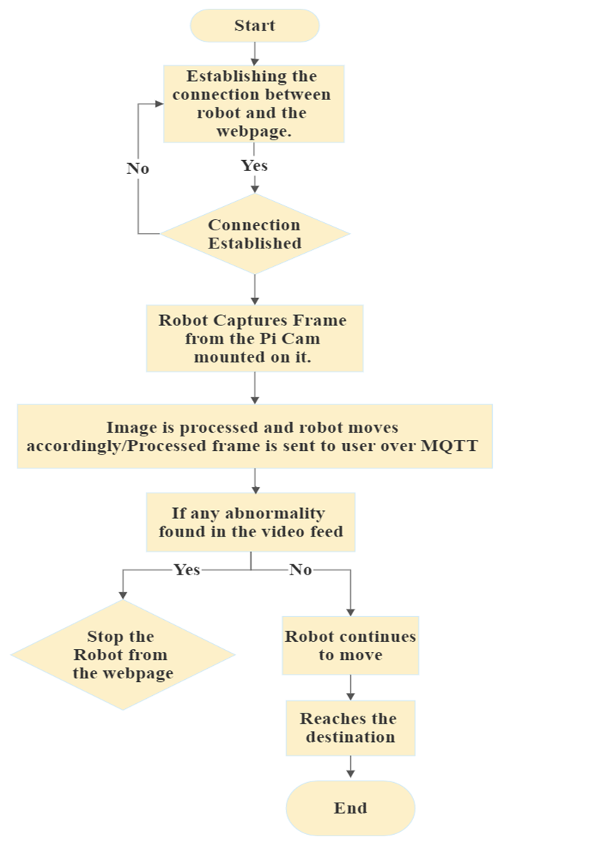
Flow Chart

Slide 13
Methodology
Assistant Robot:
In this assistant robot, the mounted camera captures the image of the path and gives it to the main module.
Using image processing, the image received from the Pi camera is processed, the curve is taken if required, and the direction is announced accordingly through the buzzer.
Finding a lane is used for lane detection.
Then, the processed image is sent to a webpage, where it can be observed by the user at a speed of 20 frames per second.

Slide 14
Methodology
The web page is designed in such a way that if the user observes anything mysterious in the processed feed on the webpage, he can stop the robot’s working remotely from the webpage itself.
The user can reach the destination of the robot and, accordingly, make the place safer for visually impaired people.
To use the robot again, the user needs to switch off the robot first and then switch it on again (it starts working).

Slide 15
Hardware & Software Required
Here are the hardware requirements to build the model
Here are the software requirements to build the model
Raspberry pi 3 model A+
Raspberry pi camera(5 Mp)
Motor Driver(LM2596)
Power source
Speaker
Robot Chassis
Python programming editor
Packages like Flask,OpenCv,Numpy etc,

Slide 16

OpenCV and Python
OpenCV-Python is a library of Python bindings designed to solve computer vision problems.
Python is a general purpose programming language started by Guido van Rossum that became very popular very quickly, mainly because of its simplicity and code readability. It enables the programmer to express ideas in fewer lines of code without reducing readability.

Slide 17
Results
The final outcome of this project would be a moving robot which helps in visualizing the surroundings around us.
Not only the above application this prototype also helps in guiding the blind people, Old people to their destination precisely.

Slide 18
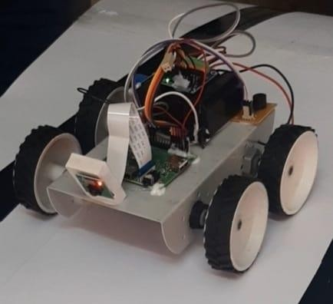
Prototype

Slide 19
Applications
This prototype helps in assisting visually impaired people to their destination and also helps in monitoring the surroundings through the path precisely.
Used to visualize the video output through out the path.
Image processing helps in making the project more efficient.
Used for security purposes as well.

Slide 20
Conclusion and Future Scope
The fully developed robot helps in assisting visually impaired people to reach their destination in a precise way.
This model also helps in visualizing the surroundings through out the path of the prototype.
In the further stages of implementation we can include the applications like:
1) Traffic sign detection
2) Obstacle detection etc,

Slide 21
References
1) Jun Zhang, and Guangming Song, “An Indoor Security with a Jumping Robot as the Surveillance Terminal,” IEEE Transactions on Consumer Electronics, Vol. 57, No. 4, November 2011.
2) L.L. Yang, S.H. Yang, and F. Yao, “Safety and Security of Remote Monitoring and Control of intelligent Home Environments,” IEEE Int. Conf. on Systems, Man, and Cybernetics, vol. 2, Taipei, Taiwan, 2006, pp. 1149-1153
3) A. U. Bokade and V. R. Ratnaparkhe, "Video surveillance robot control using smartphone and Raspberry pi," 2016 International Conference on Communication and Signal Processing (ICCSP), Melmaruvathur, 2016, pp. 2094-2097.

Slide 22
4) SHIN, Moon & KIM, Byung & HWANG, Seon & KO, Myeong. (2016). Design and Implementation of IoT-based Intelligent Surveillance Robot. Studies in Informatics and Control. 25. 10.24846/v25i4y201603.
5) Ashokkumar, M & T., Thangavelu. (2018). Integrated IOT based design and Android operated Multi-purpose Field Surveillance Robot for Military Use. 10.2991/pecteam- 18.2018.42.
6) Nayyar, Anand & Puri, Vikram & Nhu, Nguyen & Le, Dac-Nhuong. (2018). Smart Surveillance Robot for Real-Time Monitoring and Control System in Environment and Industrial Applications. 10.1007/978-981-10-7512-4_23

Slide 23
7) R, Harshitha & Hussain, Muhammad. (2018). Surveillance Robot Using Raspberry Pi and IoT. 46-51. 10.1109/ICDI3C.2018.00018.
8) Rashid, Md Tahmid & Chowdhury, Pritom & Rhaman, Md. Khalilur. (2015). Espionage: A voice guided surveillance robot with DTMF control and web based control. 10.13140/RG.2.1.4896.2323.
9) M. Kumari, A. Kumar and R. Singhal, "Design and Analysis of IoT-Based Intelligent Robot for Real-Time Monitoring and Control," 2020 International Conference on Power Electronics & IoT Applications in Renewable Energy and its Control (PARC), Mathura, India, 2020, pp. 549-552, doi: 10.1109/PARC49193.2020.236673.

Slide 24
10) W. Lao, J. Han and P. H. n. De With, "Automatic video-based human motion analyzer for consumer surveillance system," in IEEE Transactions on Consumer Electronics, vol. 55, no. 2, pp. 591-598, May 2009, doi: 10.1109/TCE.2009.5174427.

